Slide 1
City of Tacoma 30 x 30 Stats
Data as of August 31, 2022

Slide 2
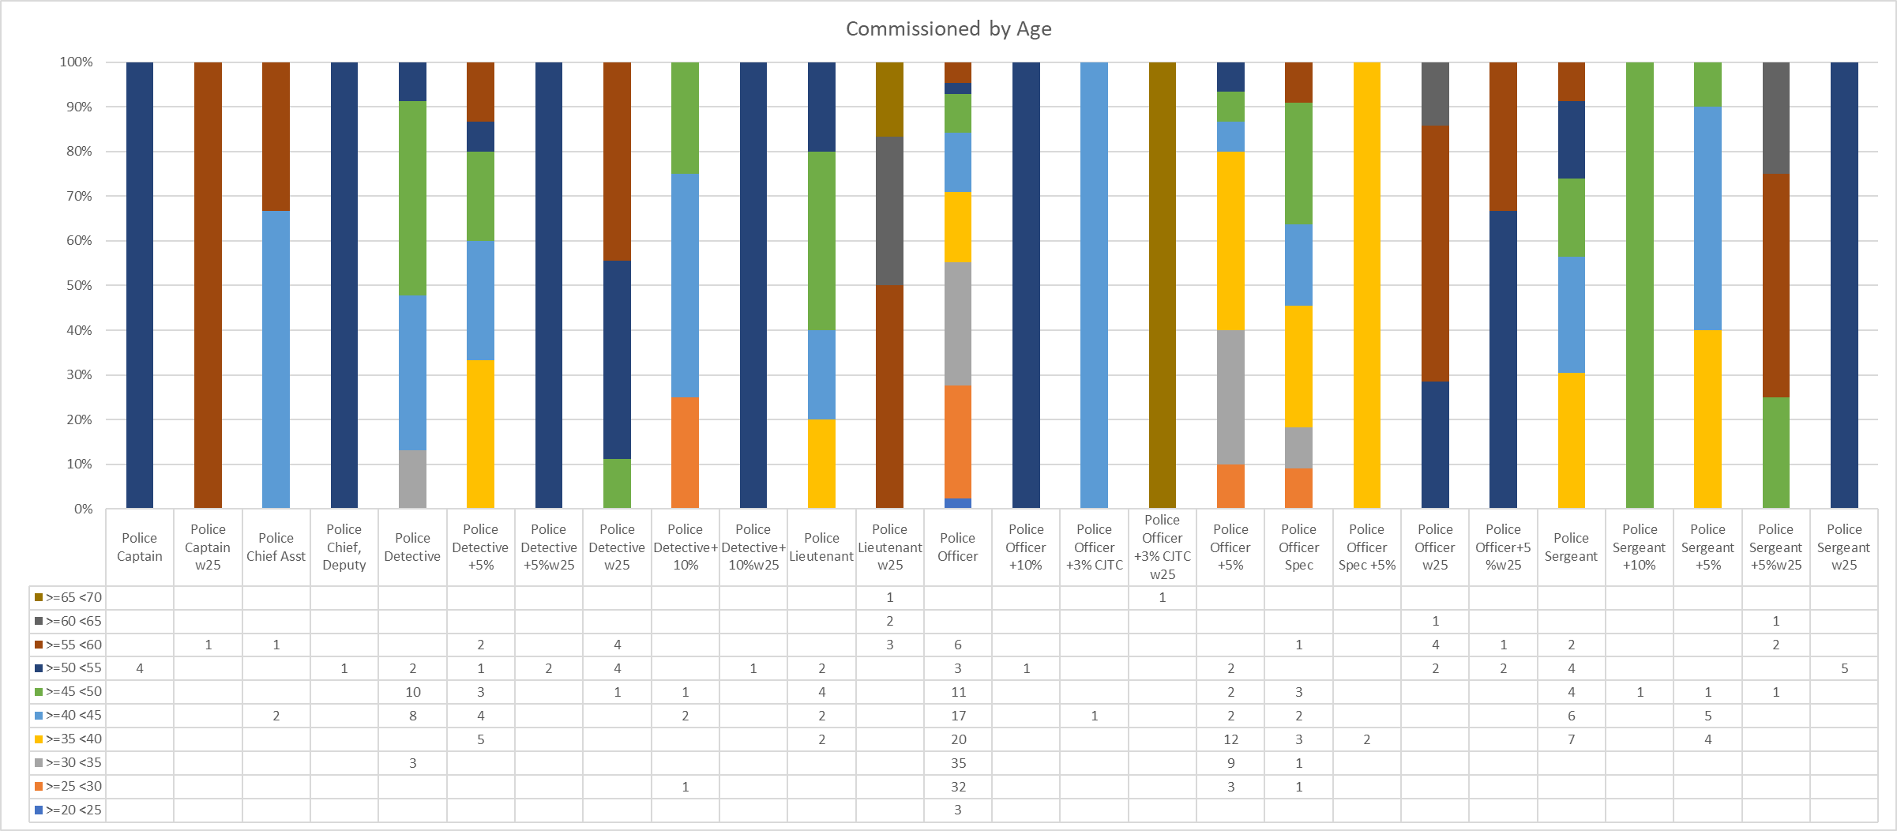

Slide 3
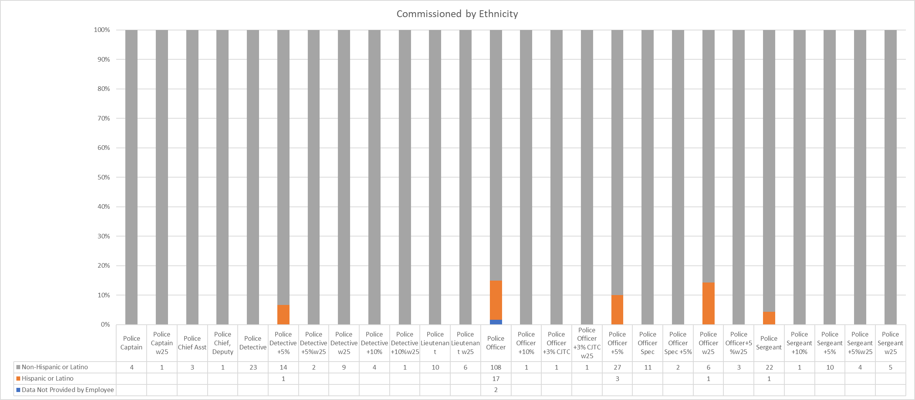

Slide 4
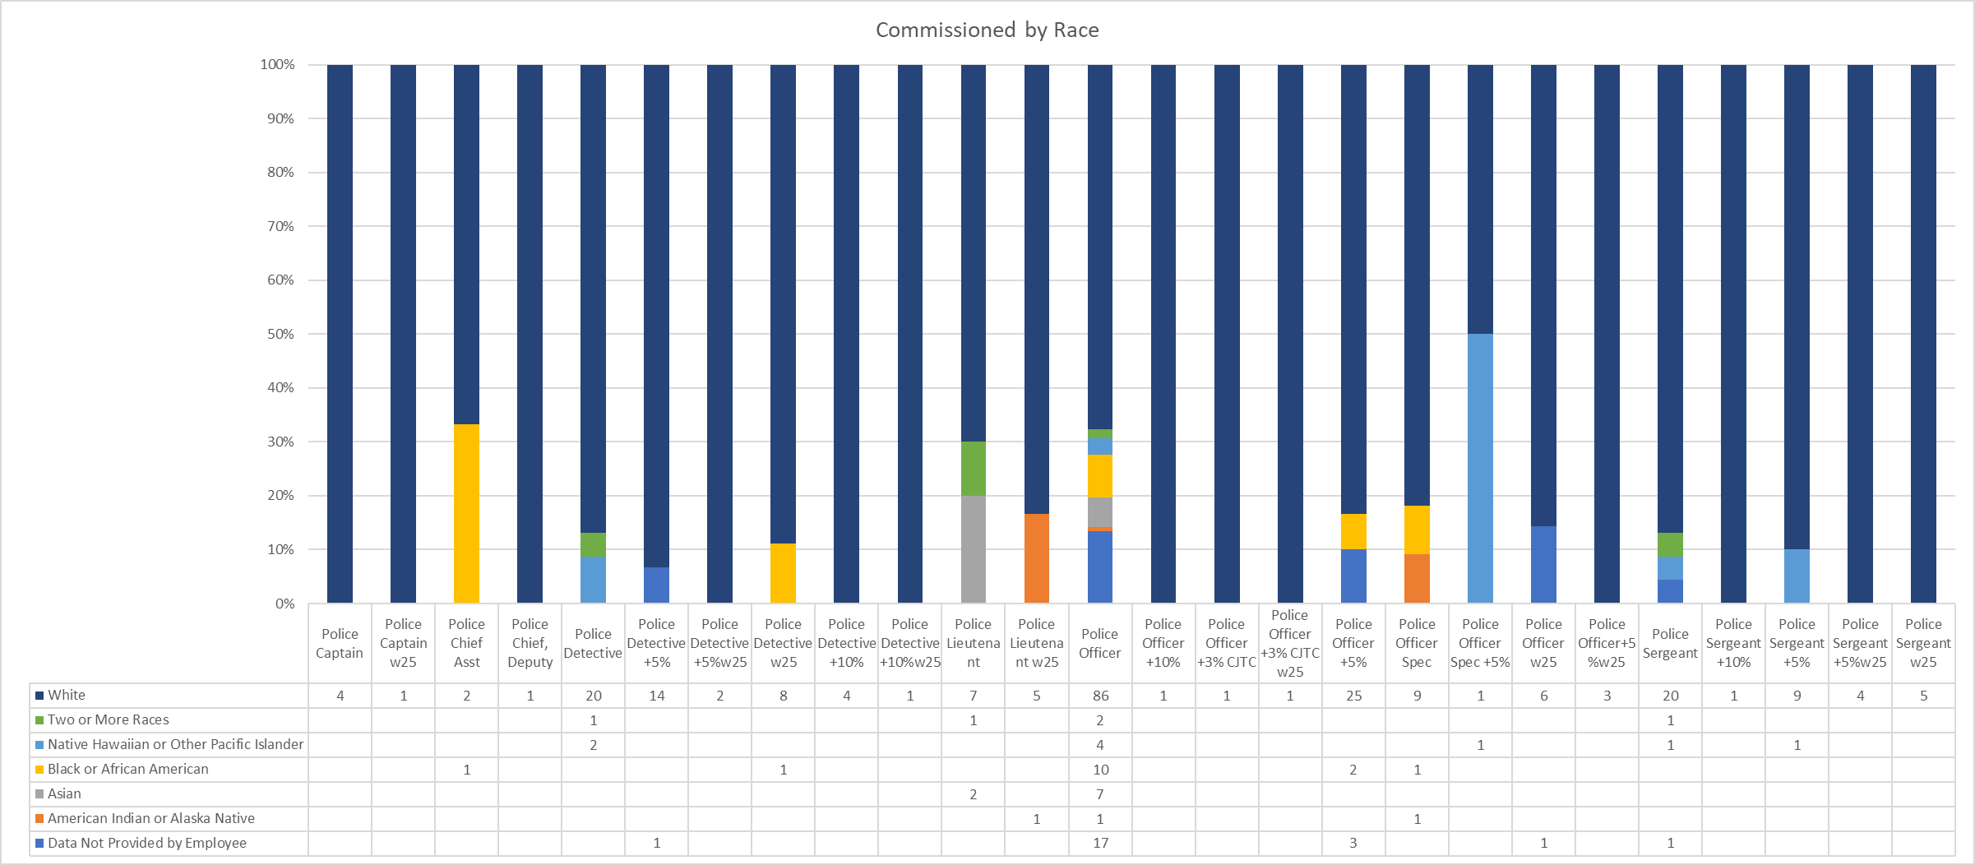

Slide 5
